Slide 1
Example: Message Board front-end (Part 2)
Showing and Deleting Messages | Adding Messages | Editing Messages
Notes:
Welcome to our lecture on Example of message board front-end part 2. In this lecture we will go through how to show messages, delete messages, add messages, and edit messages. Let’s start the video lecture.

Slide 2
Showing and Deleting Messages
Message component displays a message inside a Card with a delete button.
CloseButton (X) deletes the message, and Link (pencil) navigates to edit.
ReactTimeAgo shows relative timestamps (e.g., "2 minutes ago").
MessageList fetches messages, deletes messages, and shows a Spinner while loading.
Notes:
Now that we’ve introduced the topic, let’s take a closer look at how messages are displayed and removed. The interface organizes each message with options to edit or delete. A button allows users to remove messages, while another enables modifications. The system also converts timestamps into a user-friendly format and dynamically loads messages for a seamless experience.

Slide 3
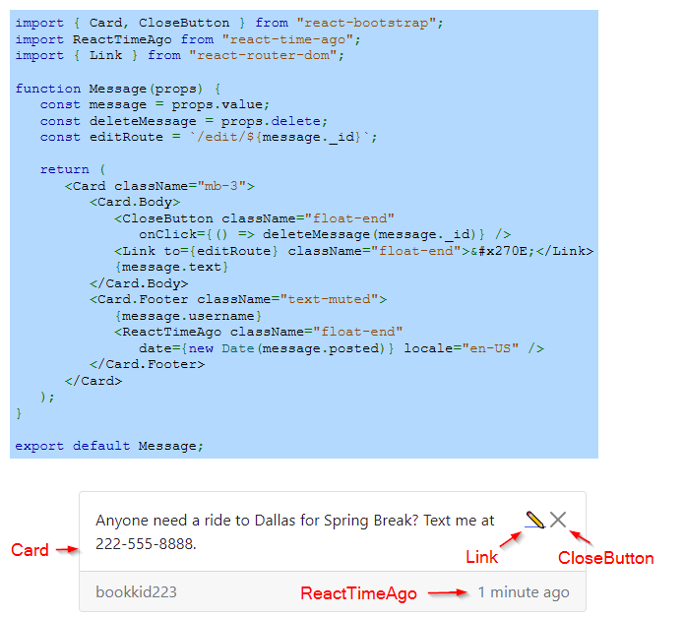
Example
Notes:
Now that we have discussed how messages are displayed and removed, let’s look at how this functionality is implemented. The interface organizes each message inside a structured layout. A button is provided for removing messages, while another allows modifications. The system also converts timestamps into a user-friendly format.

Slide 4
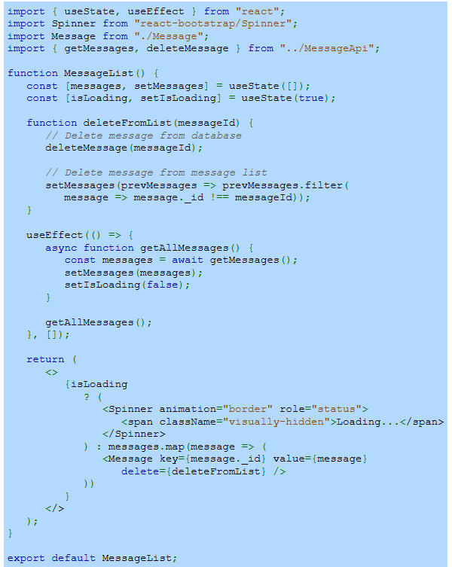
Example (Continue)
Notes:
Building on the previous example, this part of the implementation handles retrieving and managing messages. The system fetches data from the server and dynamically updates the list. It also includes a way to remove messages both from the interface and the database. While loading, a visual indicator provides feedback, ensuring a smooth user experience.

Slide 5
Adding Messages
AddMessage component renders a form for adding messages.
Add button saves the message and returns to the message list.
useNavigate() hook enables programmatic navigation with goBack().
Notes:
Now that we have seen how to display and remove messages, let’s explore how users can add new ones. The interface includes a form where users can enter a name and message. Once submitted, the message is saved and the user is taken back to the list. If they choose to cancel, the system smoothly navigates them back without saving any changes.

Slide 6
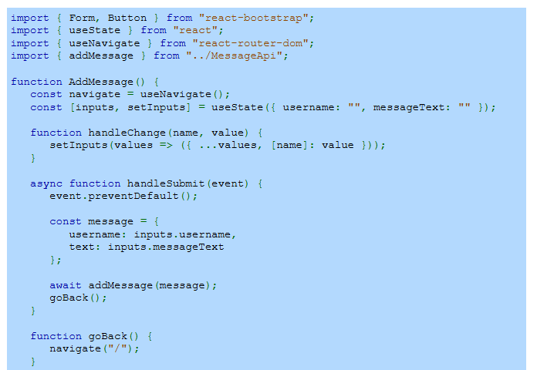
Example
Notes:
Now that we have introduced adding messages, let’s look at how this functionality is built. The system captures user input and updates the message list. The user provides details through a structured form, and the information is processed when submitted. The system then ensures the data is stored and allows seamless navigation within the interface.

Slide 7
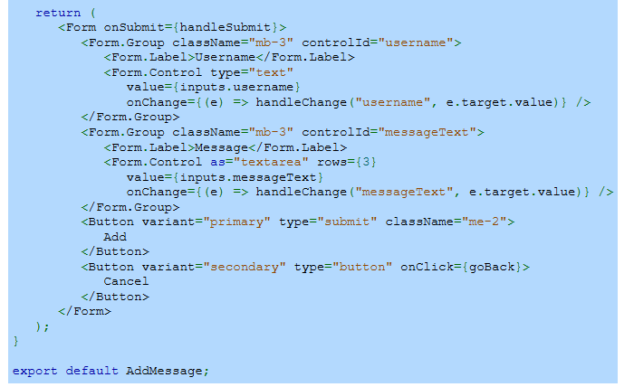
Example (Continue)
Notes:
Expanding on the previous implementation, this part focuses on structuring the form and handling user interactions. The form collects input, updates values, and ensures proper submission. Buttons provide the option to save or cancel, offering flexibility in user actions. This allows for smooth message entry while maintaining a responsive and user-friendly experience.

Slide 8
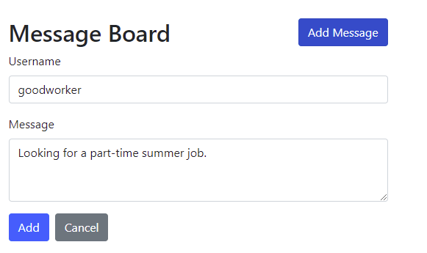
Example (Continue)
Notes:
Now, let’s see how everything comes together visually. The form is presented with fields for entering details, making it easy for users to contribute messages. With clear buttons for submission and cancellation, the interface provides a simple yet effective way to manage messages. This completes the process of adding new messages to the application.

Slide 9
Editing Messages
EditMessage component displays a form pre-filled with the existing message.
getMessage() fetches the message data for editing.
editMessage() saves changes, and the project starts with npm start.
Notes:
Now that we have covered adding messages, let’s move on to editing existing ones. The system loads the message into a form, allowing users to make changes. It retrieves the message details and pre-fills the form with the existing content. Once the user updates the information and submits, the system saves the changes, ensuring a smooth and efficient editing process.

Slide 10
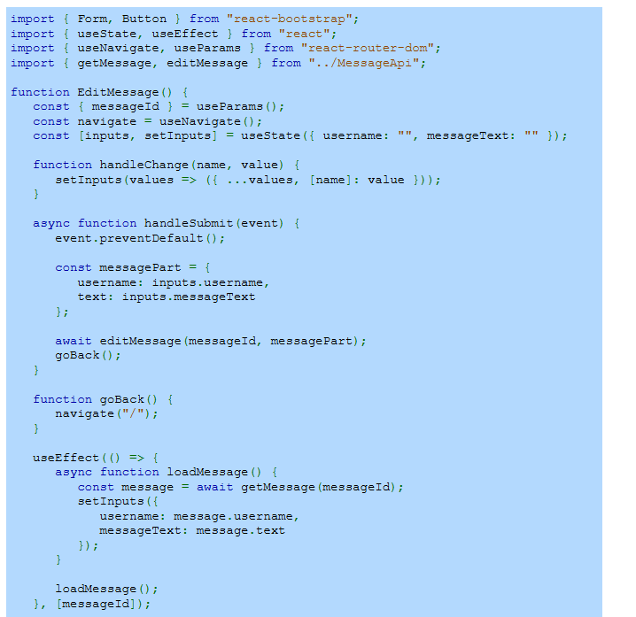
Example
Notes:
Now that we understand how messages are edited, let’s explore the implementation. The system retrieves the existing content and pre-fills the form. Users can modify the details and submit changes. The system ensures the updated content is processed correctly, allowing for seamless editing and maintaining a smooth user experience.

Slide 11
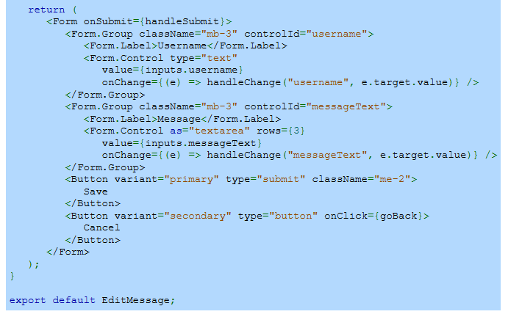
Example (Continue)
Notes:
Expanding on the previous step, this part focuses on structuring the form and handling user interactions. The form collects the updated details and allows changes to be saved or canceled. The system validates the input and ensures smooth navigation. With a clear and responsive design, users can easily update messages without complications.

Slide 12
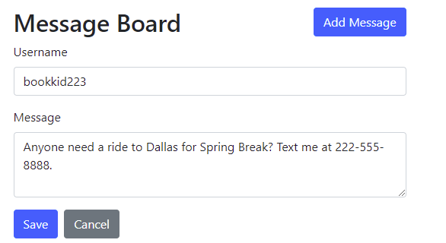
Example (Continue)
Notes:
Here, we see how everything appears on the interface. The pre-filled form allows users to modify details with ease. The design ensures an intuitive experience with simple buttons for saving or canceling changes. This completes the editing functionality, making it easy for users to update messages while maintaining efficiency in the system.

